Slide 1

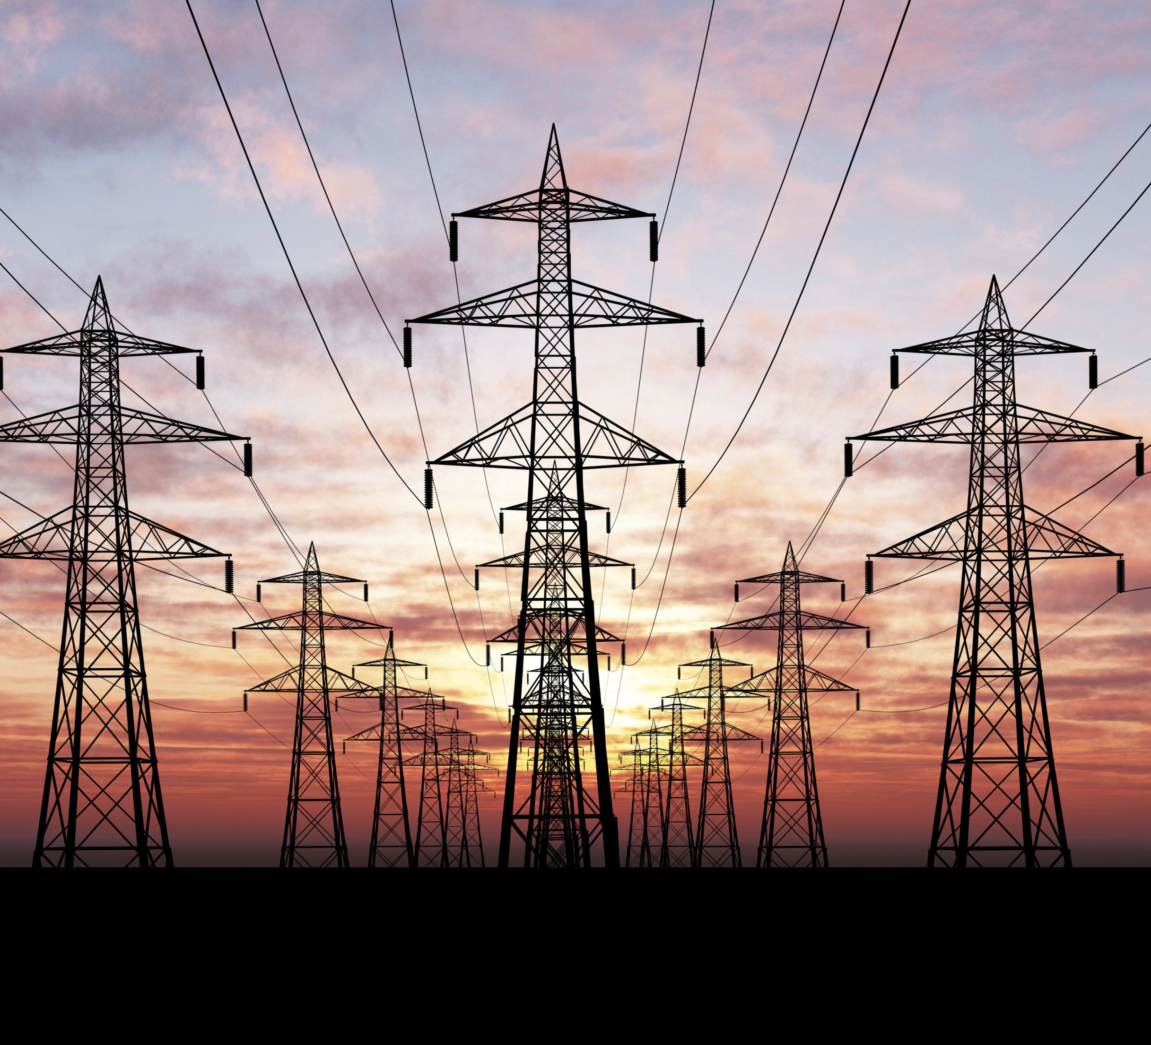
Analysis of Hourly Energy Consumption Over 10 Year Period
FINAL PROJECT
Arpit Agarwal
Avi Manawat
Aakash Kotha

Slide 2
PROBLEM STATEMENT
Electricity became an integral part of everyday life. From the time we get up and till we sleep we need it in every way like charging a phone, cooking, air conditioning while sleeping.
Increasing population and cities expanding every day, knowing the trends and understanding the usage patterns helps electric companies to plan their power outputs and understand areas where new substations or power stations would be needed.

Slide 3

DATASET:
The data set is 10 years Hourly Energy Consumption data from PJM in Megawatts (MW).
The hourly power consumption data comes from PJM's website .
PJM Interconnection LLC (PJM) is part of the Eastern Interconnection grid operating an electric transmission system serving all or parts of Delaware, Illinois, Indiana, Kentucky, Maryland, Michigan, New Jersey, North Carolina, Ohio, Pennsylvania, Tennessee, Virginia, West Virginia, and the District of Columbia.
The regions have changed over the years so data may only appear for certain dates per region.
The dataset has columns Date, Hours, Region and Energy consumption in Megawatts.

Slide 4
DATA CLEANING
We removed 2012 as there are many NA values. Periodic data is good for forecasting.
The remaining 9 years data is used for forecasting.
The remaining data has 2 missing values.
We used moving average of the same period of different years to replace the missing values.
The dataset consists of 10 years hourly energy consumption data.

Slide 5
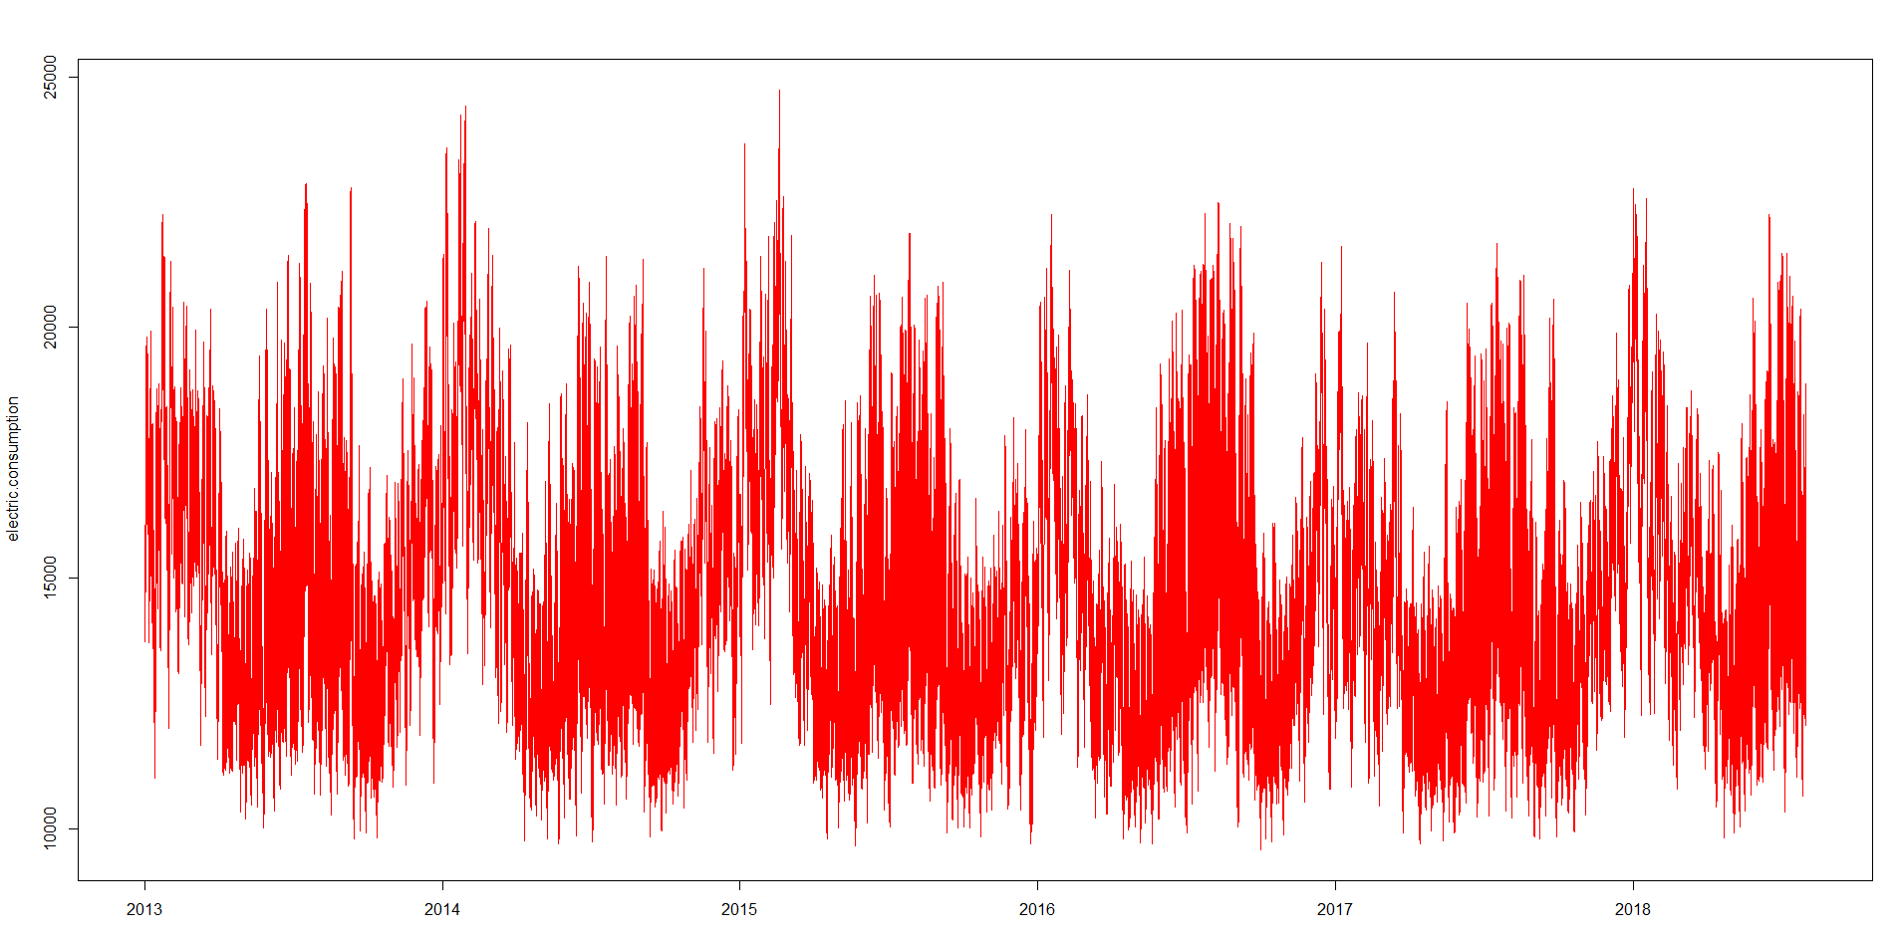
EDA Analysis
The graph shows the electricity usage trends of each year.
We can see that there is seasonality but there is no trend
Level is around 15000.
We can see that the usage of electricity is more in middle of the year than the starting and the end of each year .
There is an outlier in 2015 .

Slide 6
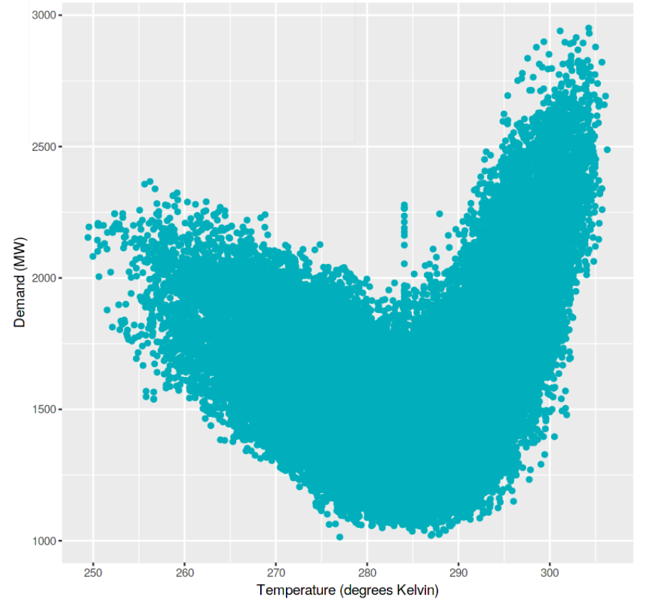
Effect of temperature on consumption of electricity
From the graph we can clearly indicate that during extreme temperatures the usage of electricity is more.
We can say that Electricity demand is more in summer and winter seasons as compared to the season with mild temperatures.
Critical temperature

Slide 7
Relation between temperature and consumption of electricity

Slide 8
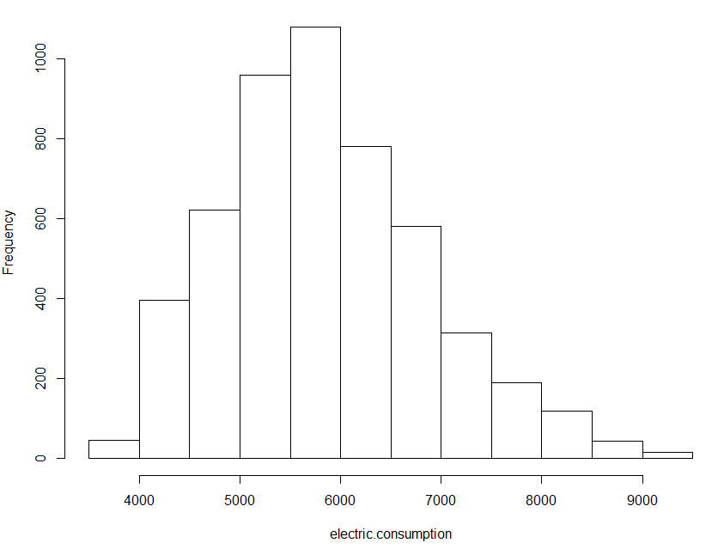
Electric Consumption Frequency Plot

Slide 9
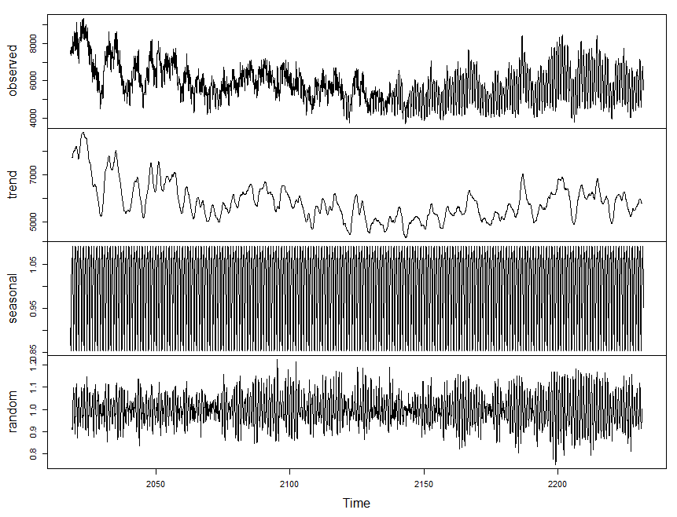
Decomposed Data

Slide 10
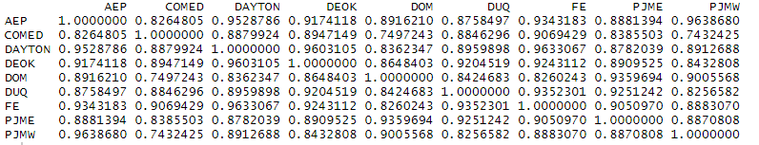
Correlation of consumption of electricity with different cities interconnections
Interconnections like COMED(serving some parts ) and DOM have different weather conditions compared to other cities interconnections and they have a correlation of 0.74.
While the other cities interconnections have a high correlation.

Slide 11
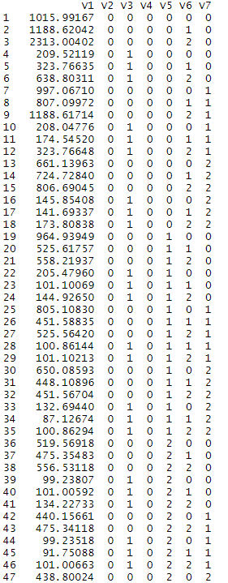
RMSE and AIC values
Model | AIC | RMSE
Holt's Winter | 123.9857 | 93348.5
Auto Arima(2,1,2) | 59330.49 | 79.78644
SRIMA(212)(111) | 58421.81 | 72.93947
SRIMA(110)(112) | 58717.14 | 74.02092
NNAR(28,1,14)[24] | 45 | 67.62381

Slide 12
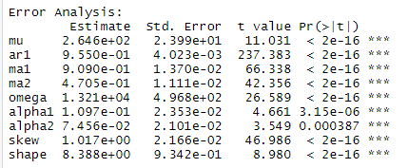
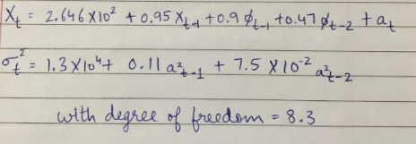
Garch Effect
Fitted Model:

Slide 13
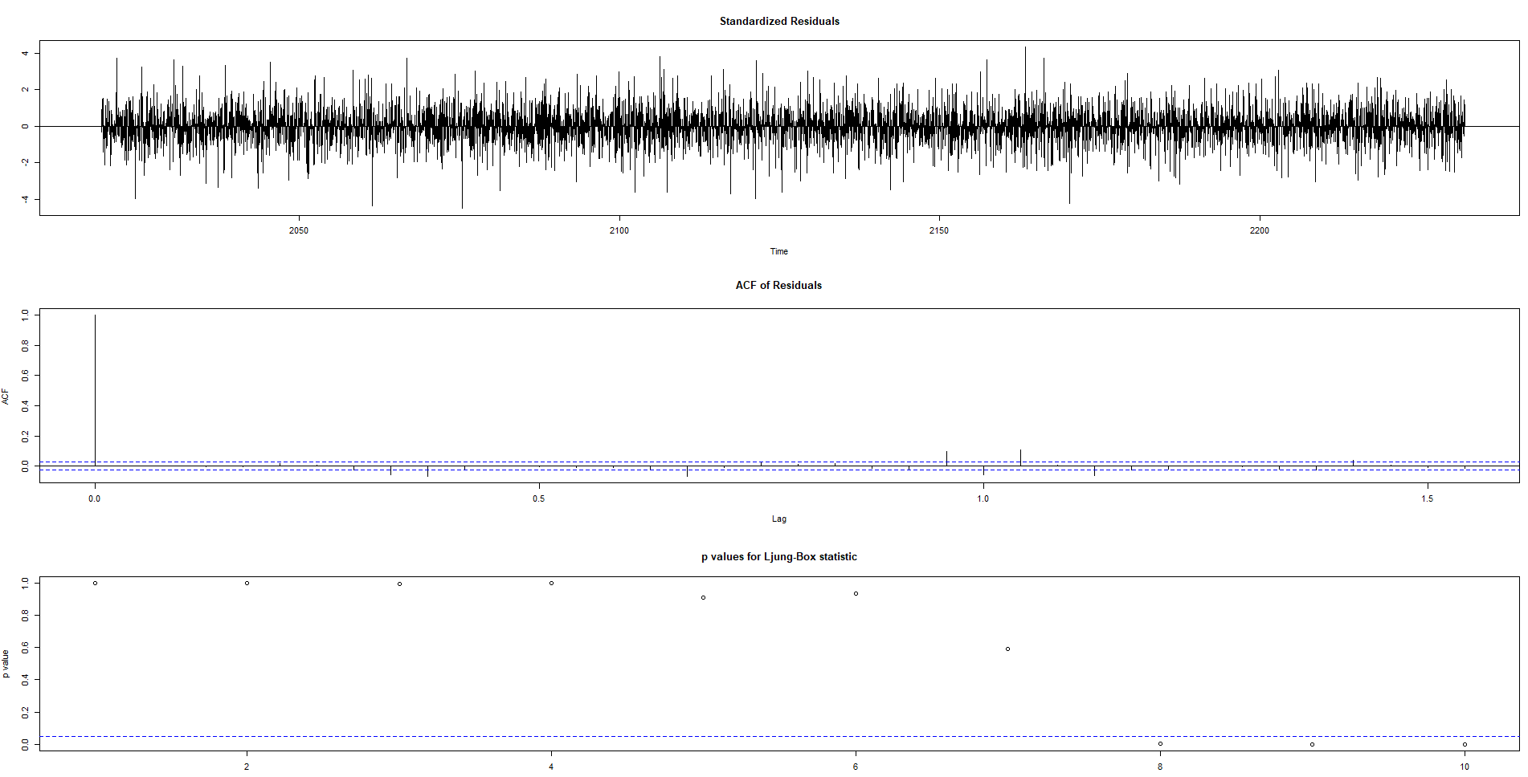
Model Diagnosis

Slide 14
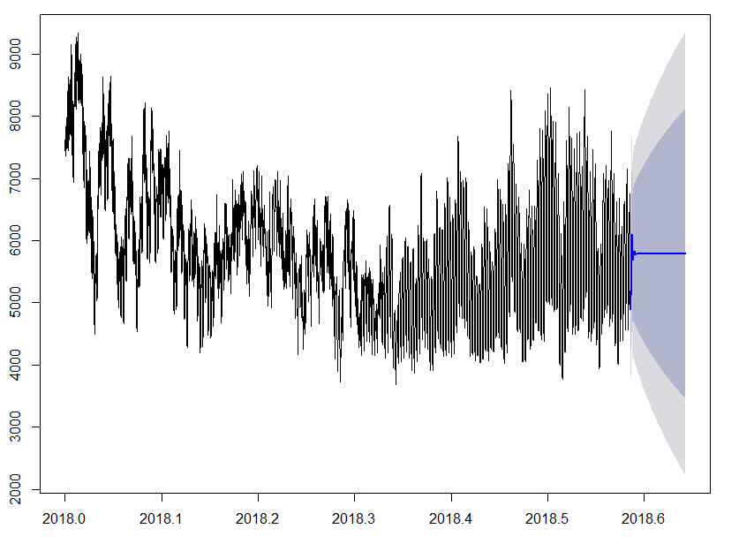
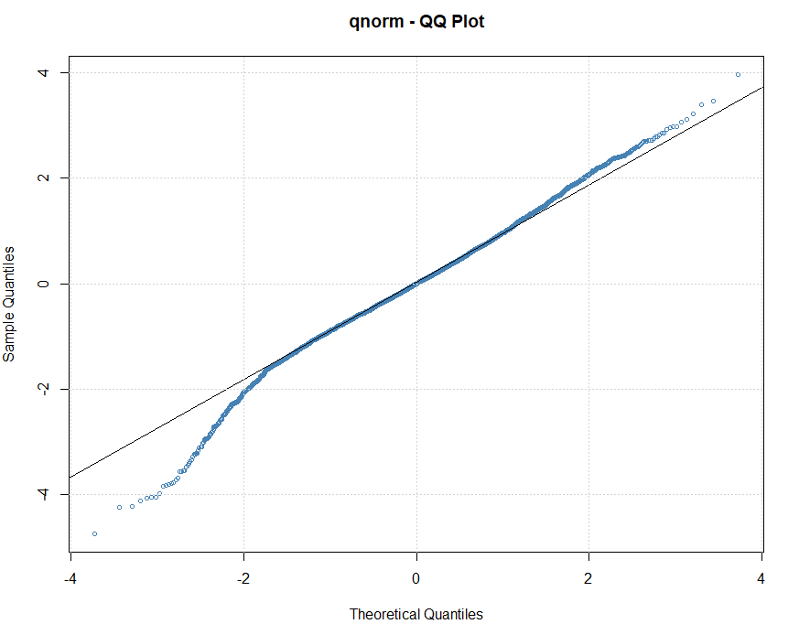
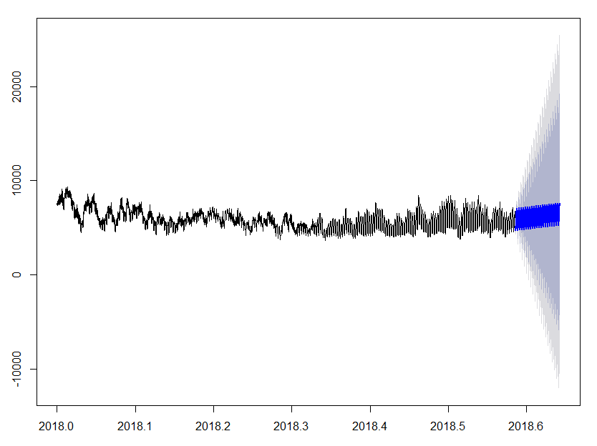
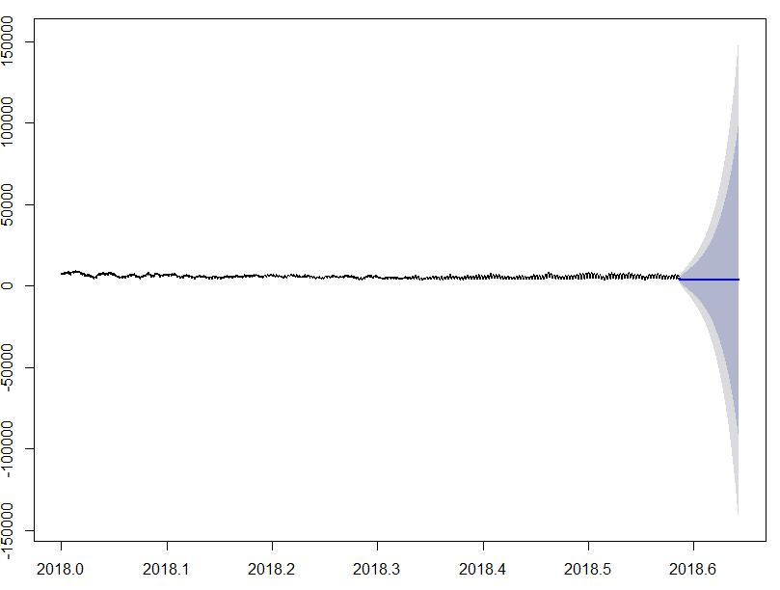
Rejected Models
Arima(2,1,2)
Garch Model
SRIMA(212)(111)[24]
Exponential Smoothing

Slide 15
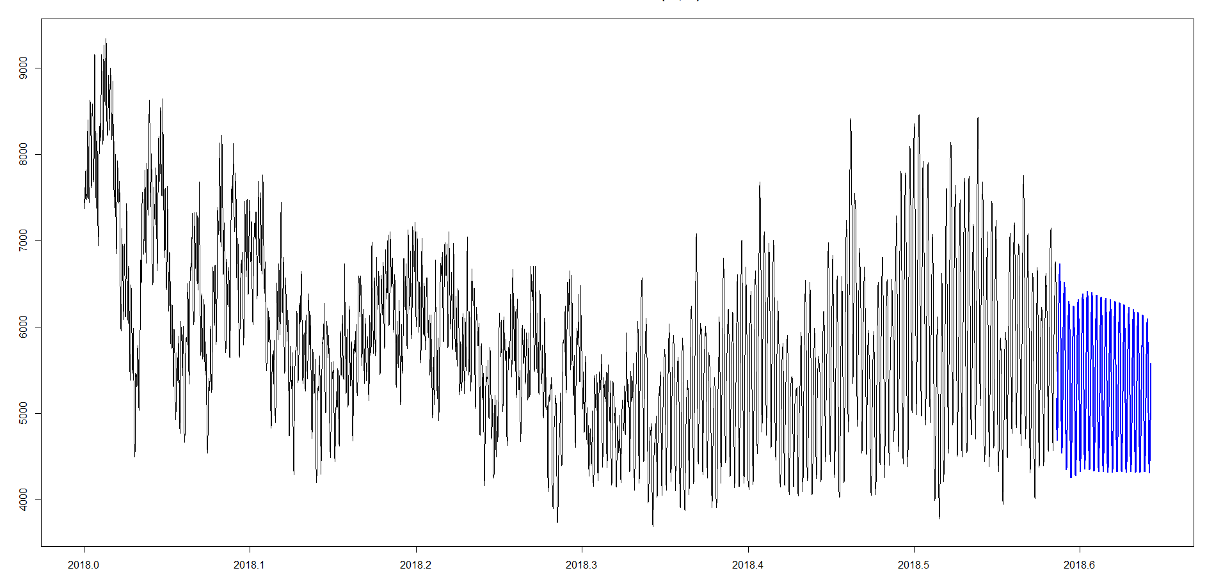
Forecasting using neural network ‘ntetar’

Slide 16

CONCLUSION
From the EDA analysis, it is evident that electricity is least used during the mild season
After trying many models, we chose to go with the ntetar (neural network) model as it provided the best fit and least errors.
On forecasting the data, we found a decrement in the demand of electricity for the coming next month.

Slide 17
RECOMMENDATIONS:
Due to COVID -19 the energy consumption might increase as people spend more time at home. Setting a daily consumption limit warning will help people keep the consumption within limit.
01
More substations need to be added or increase the capacity of energy production to meet the rapidly increasing population energy demands.
02
Spreading awareness about saving electricity that would avoid unnecessary wastage of resources.
03
Since electricity demand is low during mild season, states with mild temperatures can assist other states that have extreme temperatures with electricity supply
04

